Slide 1
Strava, EDA, and Me
Making all those activity logs more useful

Slide 2
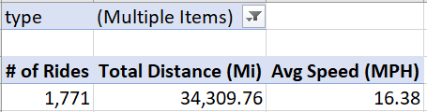
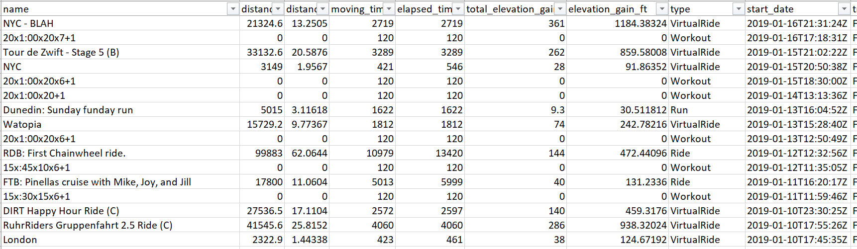
01. Statistical Question / Hypothesis
Which factor(s) have the greatest impact on average cycling speed over time?

Slide 3
02. A minimum of 5 variables in your dataset used during your analysis. Consider what you think could have an impact on your question.
type – this specifies the type of activity; there are 14 categories including ‘VirtualRide’, ‘Ride’, ‘Run’, and ‘Swim’
distance_mi – the distance traveled in miles
moving_time – the number of seconds moving (versus elapsed)
total_elevation_gain – the amount of climbing (in feet) for an activity
gear_id – the gear used (e.g., which bike or running shoe)
avg_speed_mph – the average speed for a given activity
average_watts – for cycling, the average power produced for a given activity, measured in watts
average_heartrate – how fast my heart was beating on average
average_temp – in degrees Celsius

Slide 4
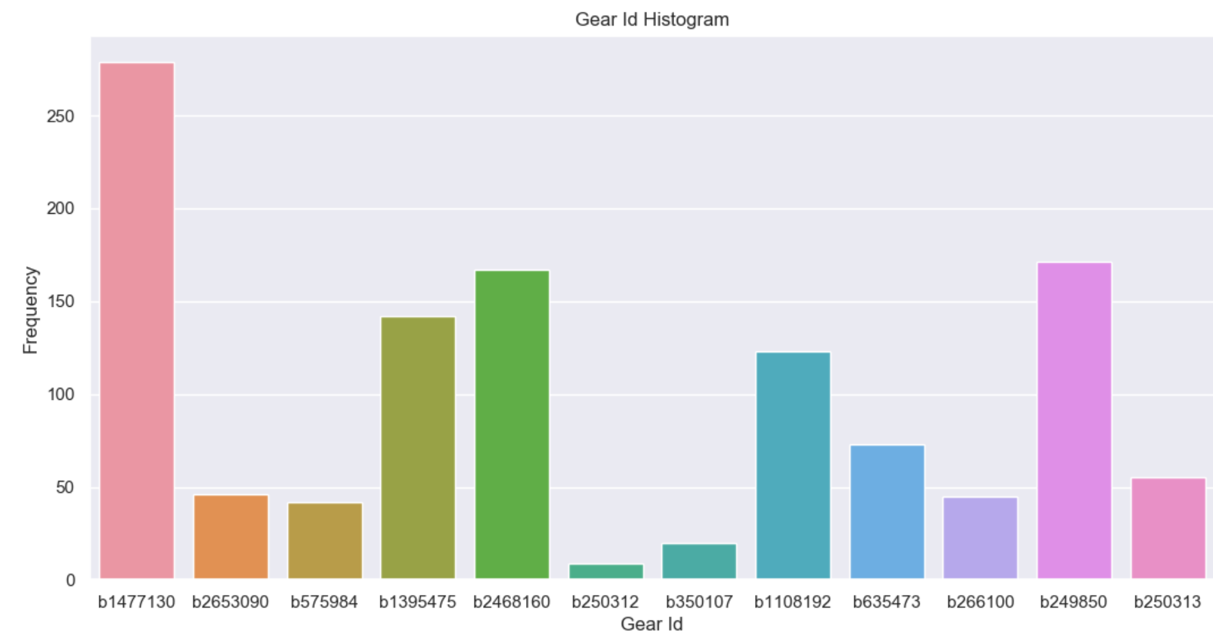
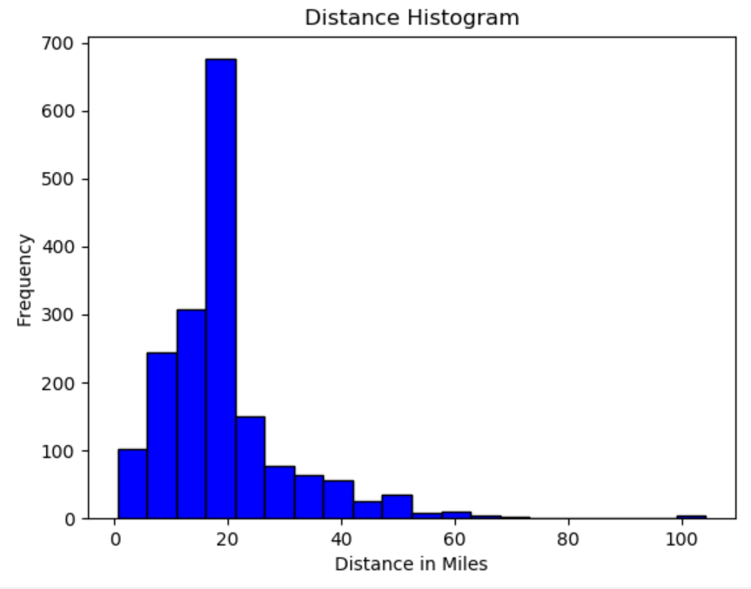
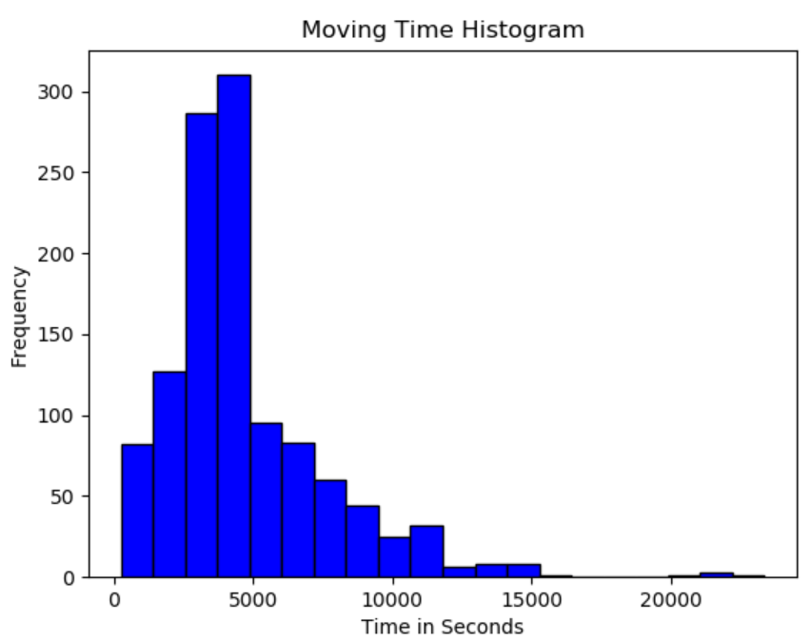
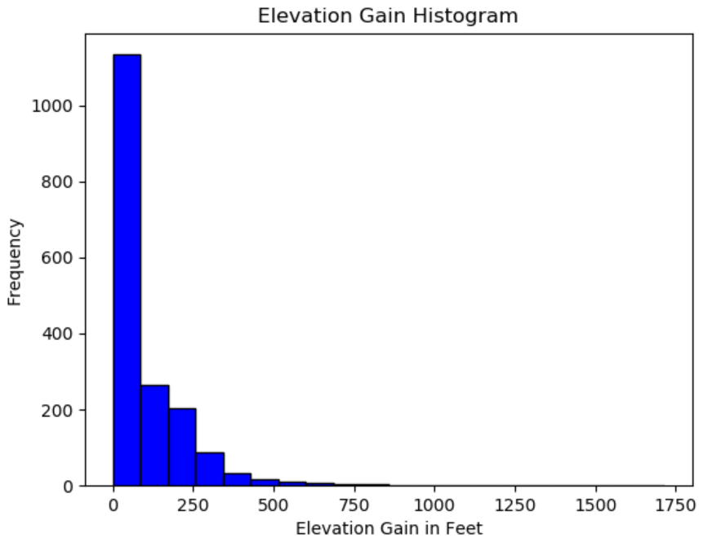
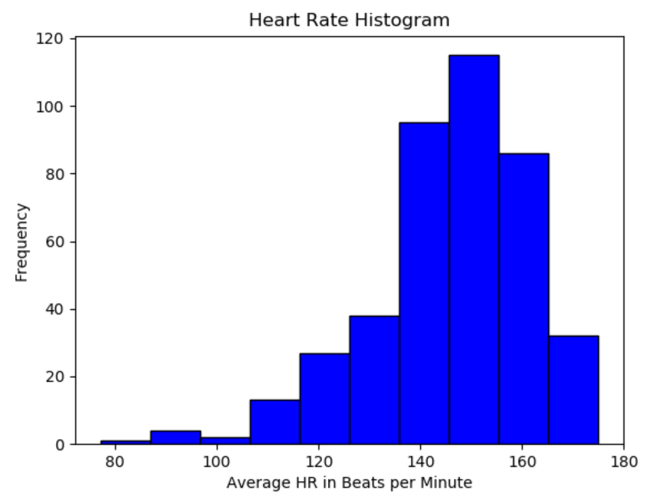
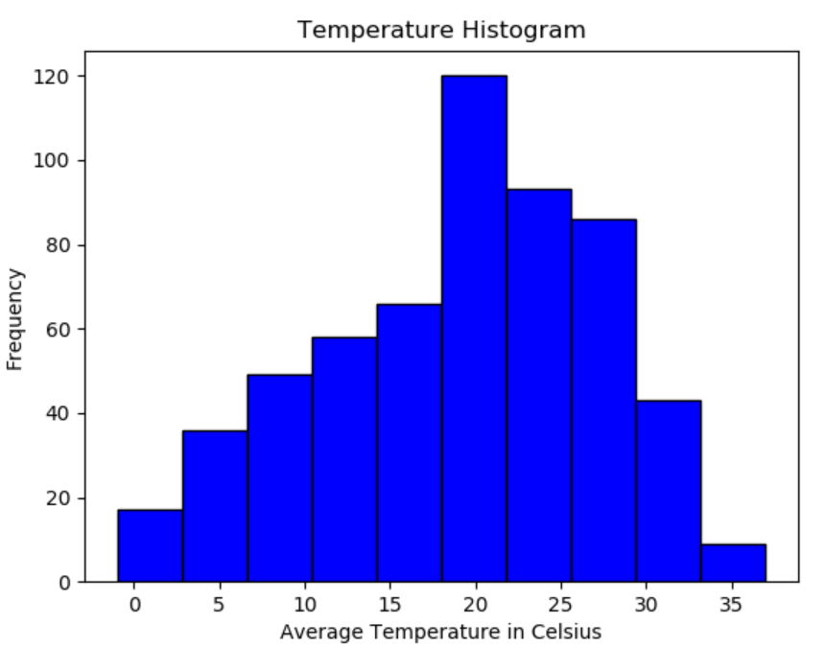
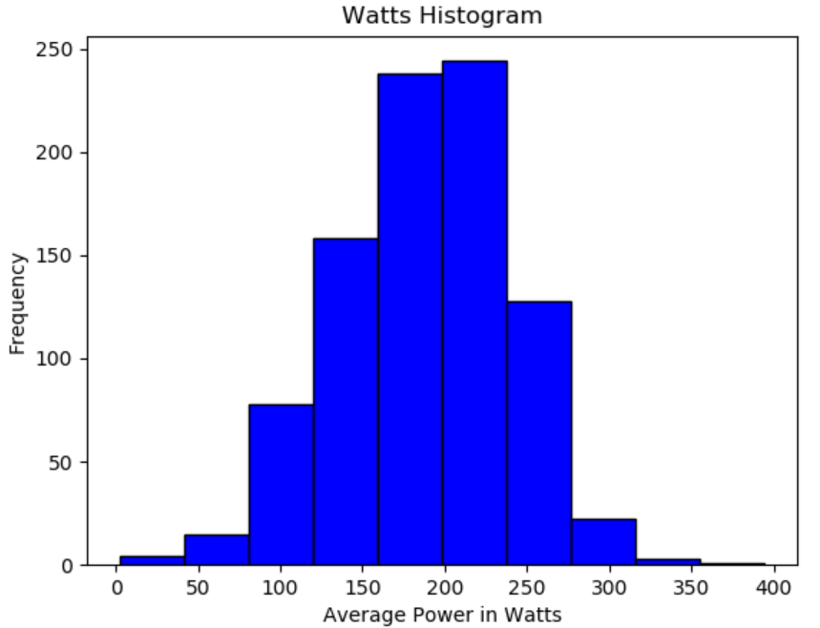
03. Include a histogram of each of the variables

Slide 5
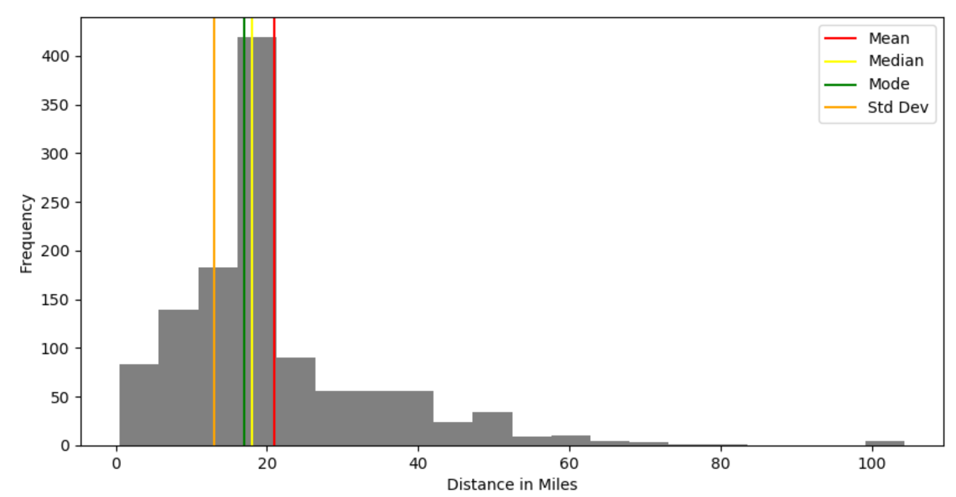
04. Include the other descriptive characteristics about the variables: Mean, Mode, Spread, and Tails. In your summary and analysis, identify any outliers and explain the reasoning for them being outliers and how you believe they should be handled.
Distance in Miles
Mean: 20.91
Median: 17.96
Mode: 17.00
Spread: 181.08
Std Dev: 13.0
There are outliers on the high-end of distance, which skew the histogram. While valid entries, they do not represent a meaningful number of entries (2) and should be removed.

Slide 6
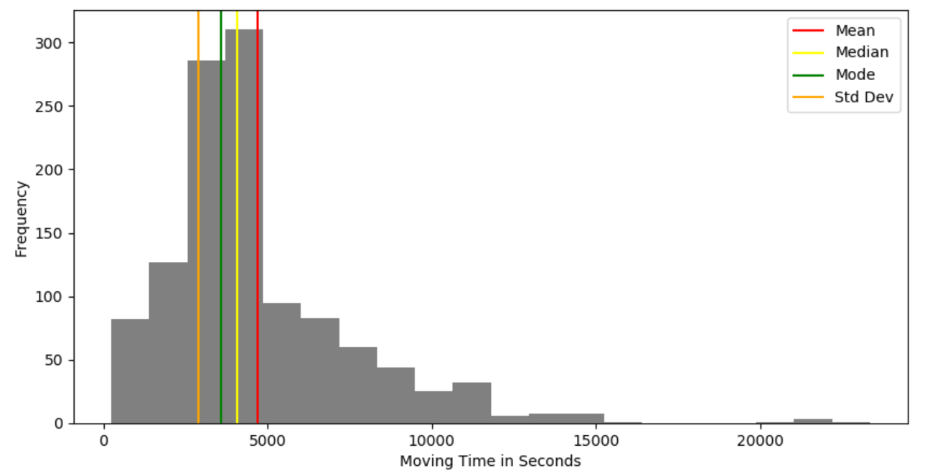
04. Include the other descriptive characteristics about the variables: Mean, Mode, Spread, and Tails. In your summary and analysis, identify any outliers and explain the reasoning for them being outliers and how you believe they should be handled.
Moving Time in Seconds
Mean: 4698.61
Median: 4080.5
Mode: 3600
Spread: 8510995.19
Std Dev: 2917.0
There are outliers on the high-end, which align exactly to distance. They too should be removed. (It may also appears that distance and time are collinear so one of these predictors is likely to be removed altogether.)

Slide 7
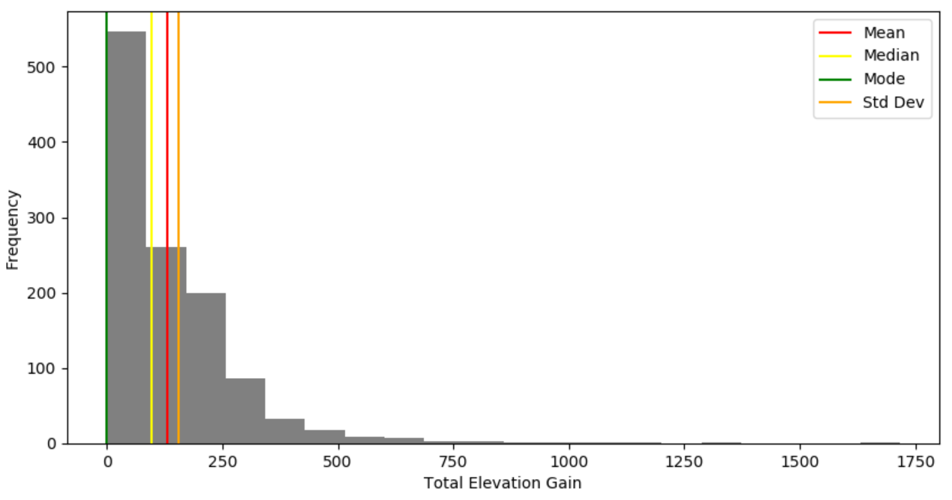
04. Include the other descriptive characteristics about the variables: Mean, Mode, Spread, and Tails. In your summary and analysis, identify any outliers and explain the reasoning for them being outliers and how you believe they should be handled.
Total Elevation Gain
Mean: 131.26
Median: 96.0
Mode: 0.0
Spread: 24485.21
Std Dev: 156.0
There are outliers on the high-end. They may be for virtual rides, where elevation gain is simulated. They may be removed, or the data may be transformed (e.g., log data). The left skew is also something that requires investigation.

Slide 8
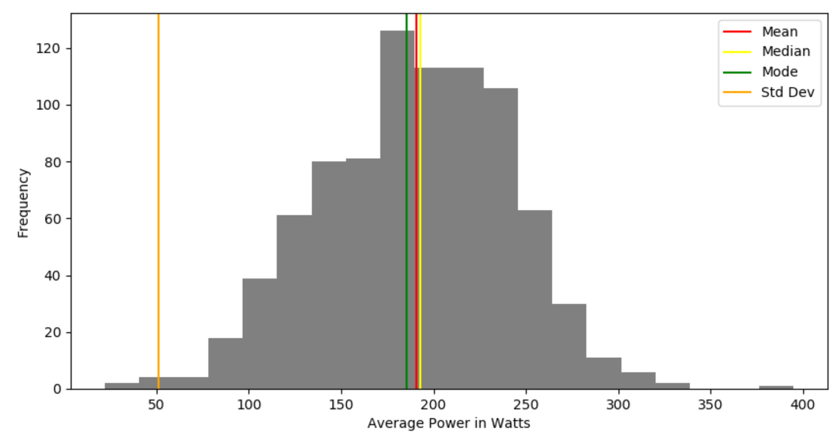
04. Include the other descriptive characteristics about the variables: Mean, Mode, Spread, and Tails. In your summary and analysis, identify any outliers and explain the reasoning for them being outliers and how you believe they should be handled.
Average Power in Watts
Mean: 190.52
Median: 192.95
Mode: 185.2
Spread: 2596.75
Std Dev: 51.0
This distribution appears fairly normalized. The mean and the mode are almost the same. No changes expected.

Slide 9
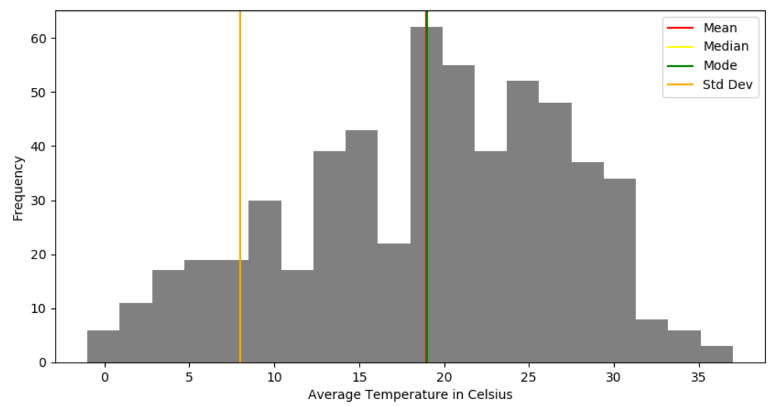
04. Include the other descriptive characteristics about the variables: Mean, Mode, Spread, and Tails. In your summary and analysis, identify any outliers and explain the reasoning for them being outliers and how you believe they should be handled.
Average Temperature in Celsius
Mean: 18.94
Median: 19.0
Mode: 19.0
Spread: 66.06
Std Dev: 8.0
There are no outliers in this otherwise reasonably normal distribution. However, the multiple humps has to be looked at carefully. The spread is likely being affected by my recent move to Florida – far more temperatures are hovering at higher (>18 degrees Celsius).

Slide 10
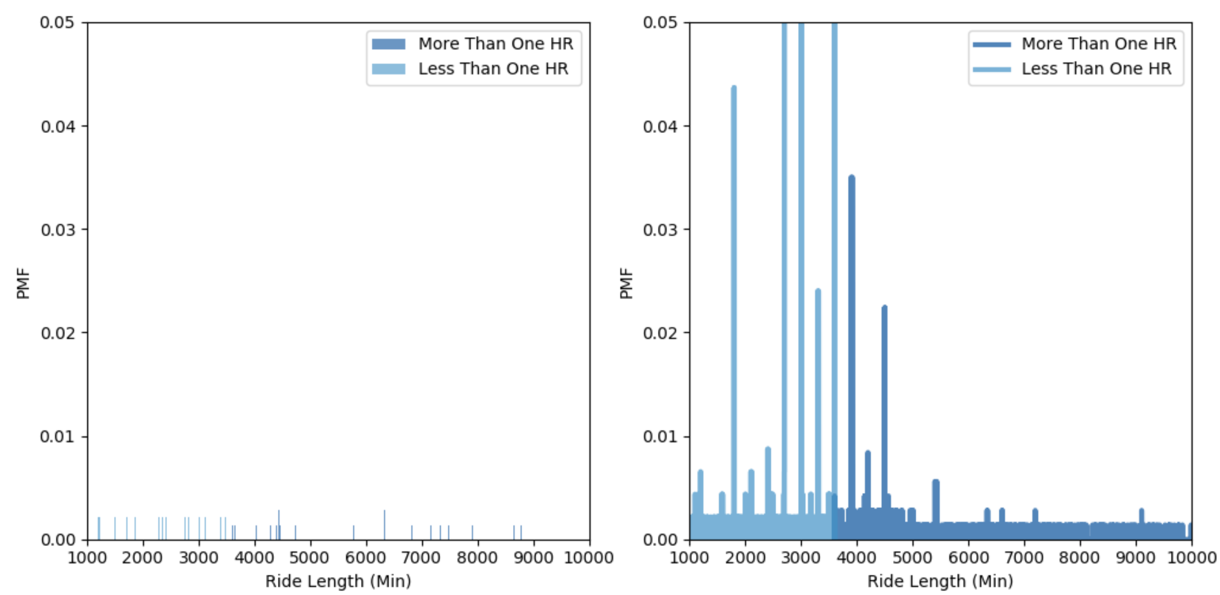
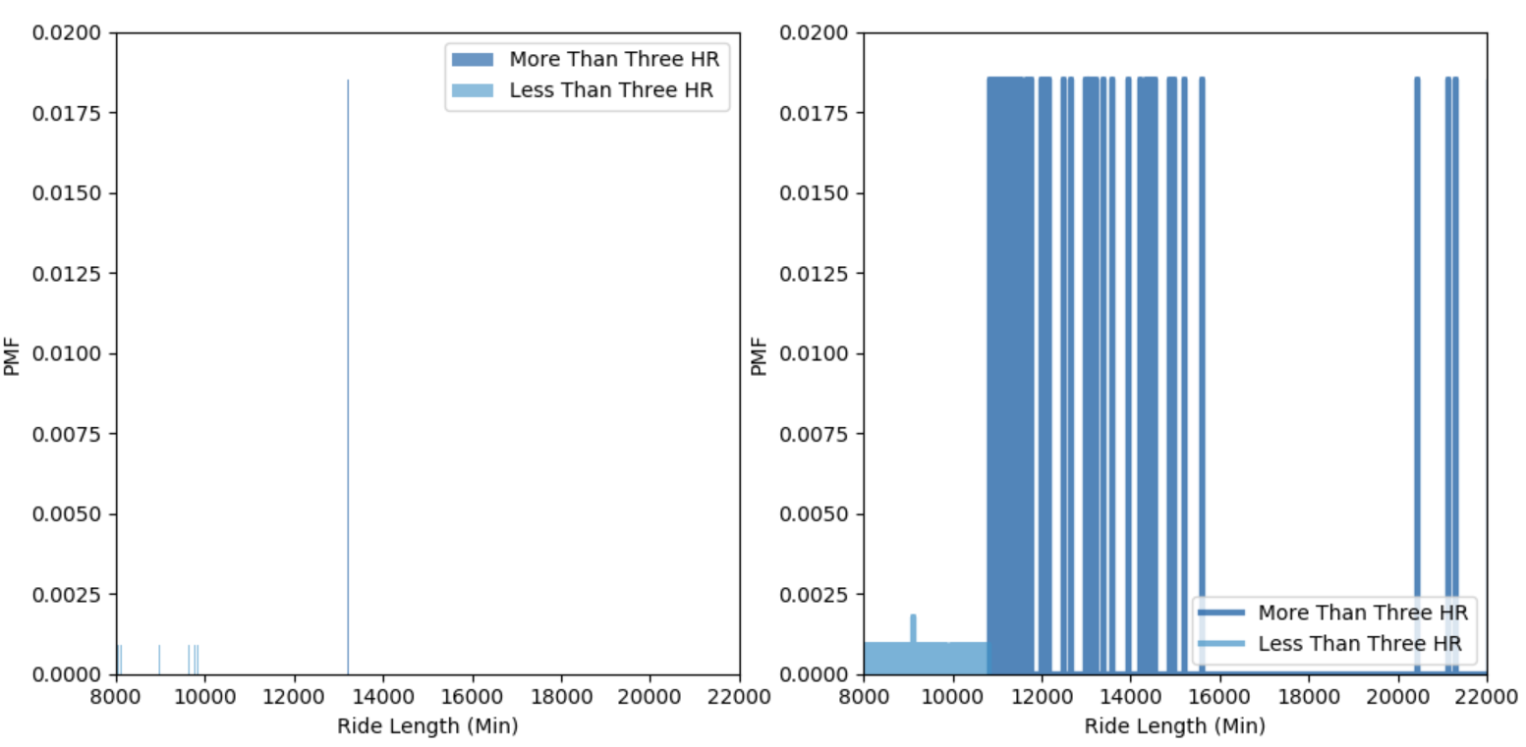
05. Compare two scenarios in your data using a PMF.
Moving Time: Scenario 1 (<=1 hr, > 1hr). Scenario 2 (<=3 hrs, > 3hrs).
It’s clear that the one hr mark has a greater importance in terms of PMF. After three hrs, the number of instance is so insignificant that the probability is approximately equal, so PMF has almost no meaning.

Slide 11
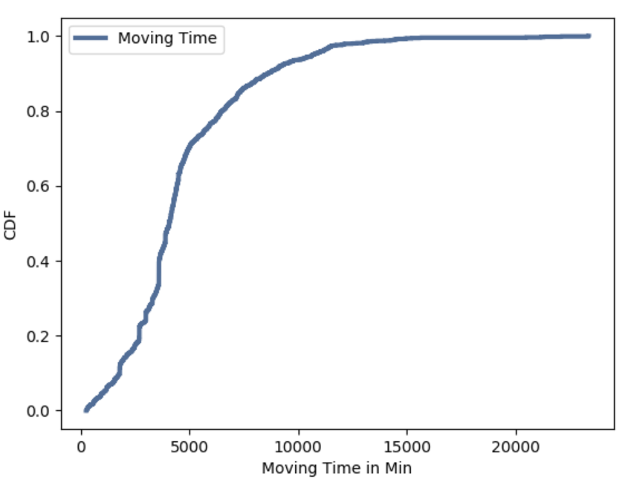
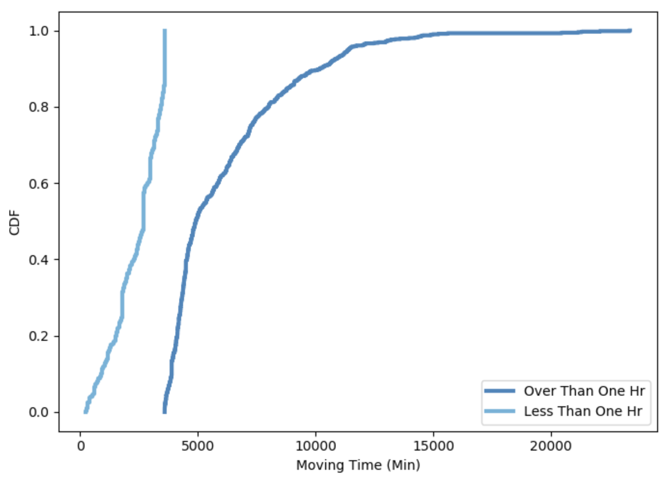
06. Create 1 CDF with one of your variables. What does this tell you about your variable and how does it address the question you are trying to answer?
Moving Time, More and Less Than One Hour
The moving_time variable has many values, so the PMF was not ideal to show the variation.
It’s much more clear that the one hour mark is an important point in terms of probability. This makes sense because earlier in my cycling life, I most frequently rode for exactly one hour.
This analysis shows what the PMF showed but in a more clear way. That is, rides less than an hour were more frequent. This analysis also shows that the CDF is a better way to measure this variable due to the large number of variables (i.e., the PMF probabilities were so slightly different from each other as to make them appear equal).

Slide 12
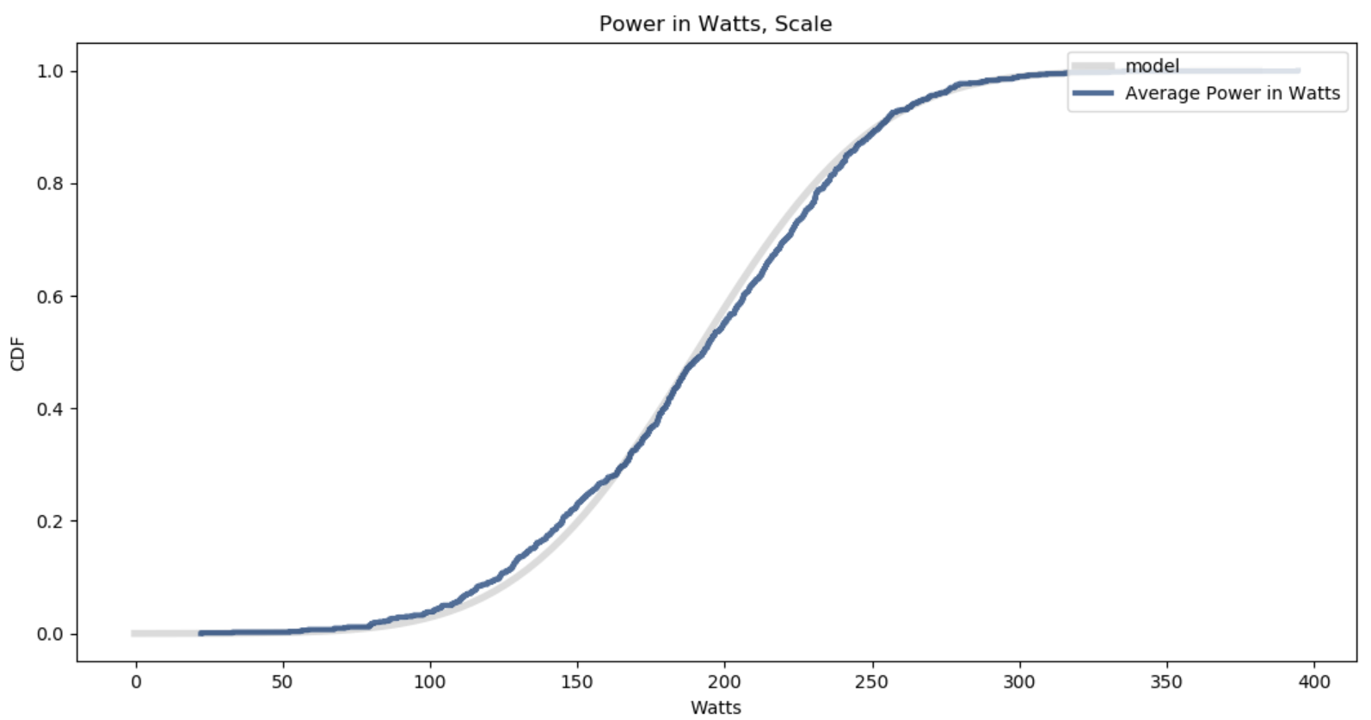
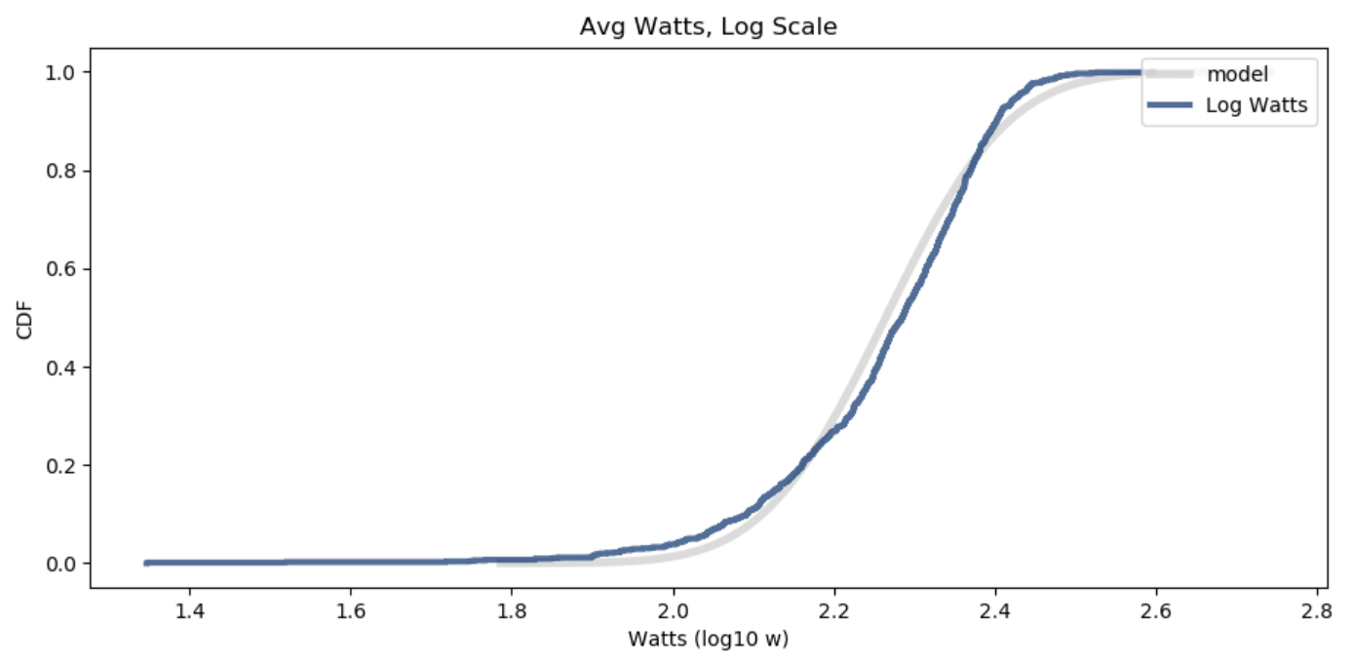
07. Plot 1 analytical distribution and provide your analysis on how it applies to the dataset you have chosen.
Average Power in Watts
Watts: n, mean, std 860 190.54 47.70
Log Watts: n, mean, std 860 2.26 0.12
This comparison shows that for average_watts, the non-logarithmic distribution is closer to the normal distribution. This is not a surprise given the histogram shown previously.
Since this was so obvious, another example is required.

Slide 13
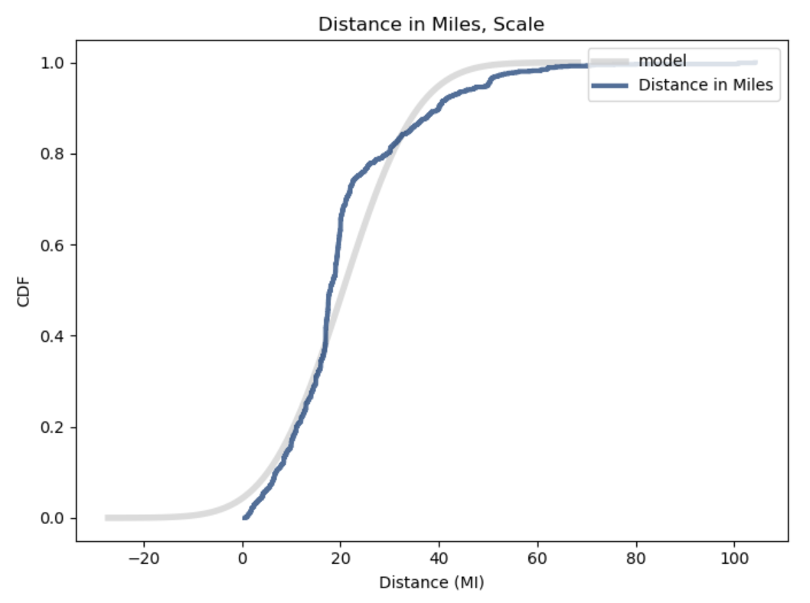
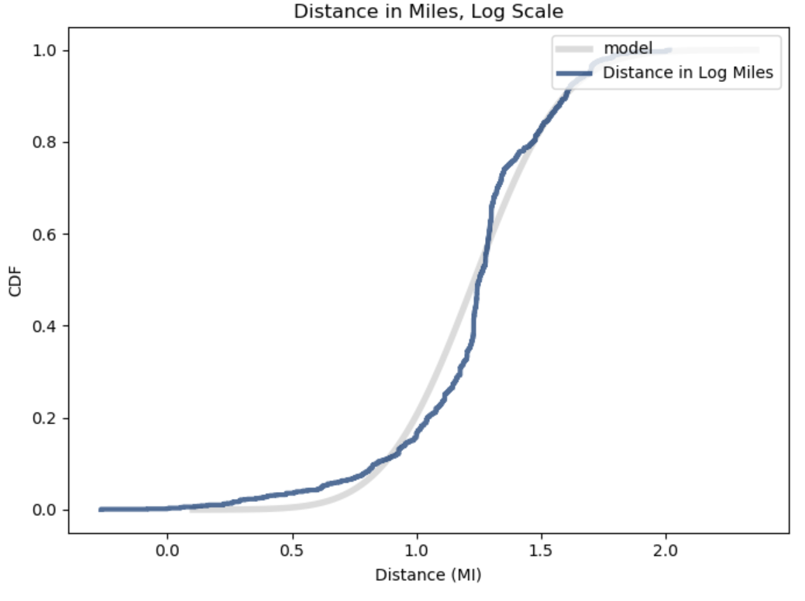
07. Plot 1 analytical distribution and provide your analysis on how it applies to the dataset you have chosen.
Distance in Miles
Distance: n, mean, std 1172 20.51 11.92
Log Distance: n, mean, std 1172 1.23 0.28
For distance_mi, the log distance in miles is much closer to the normal distribution. This transformation should be used for subsequent analysis.

Slide 14
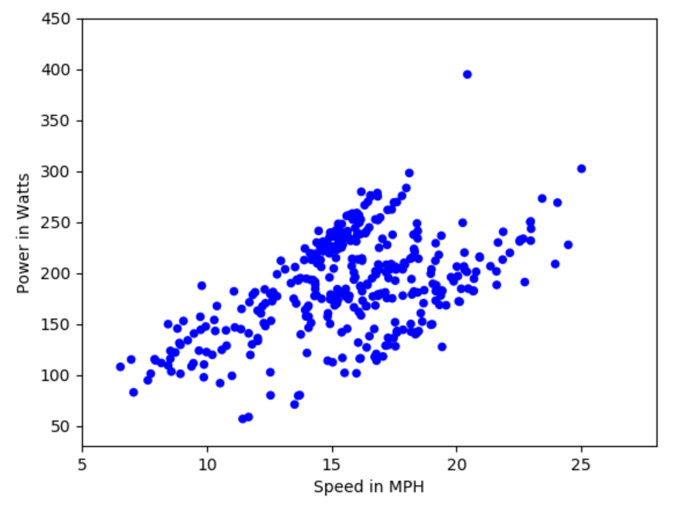
08. Create two scatter plots comparing two variables and provide your analysis on correlation and causation. Remember, covariance, Pearson’s correlation, and Non-Linear Relationships should also be considered during your analysis.
strava_data_with_watts.
Average Speed and Average Watts
The relationship appears to be linear and positive; i.e., when power goes up, average speed goes up
The distributions are relatively normal, especially power in watts
The prior two points imply that Pearson’s Correlation can be used
The correlation between avg_speed_mph and average_watts is .51, which is a strong correlation. This statistically supports the visual evidence.
While the two variables are correlated this does not imply causation. It is not accurate to say that more power creates more speed. There are many other factors that can affect speed, including bike, route, and elevation.

Slide 15
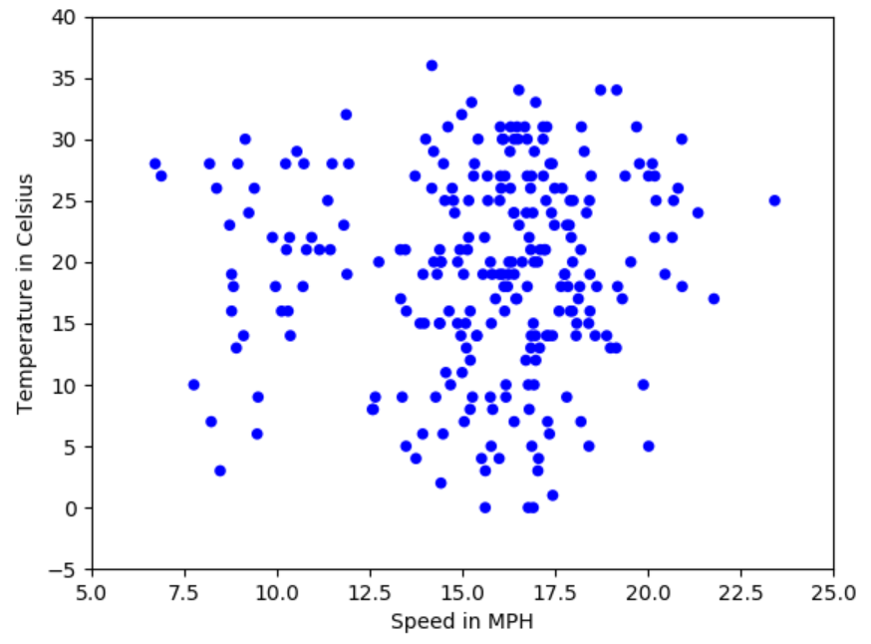
08. Create two scatter plots comparing two variables and provide your analysis on correlation and causation. Remember, covariance, Pearson’s correlation, and Non-Linear Relationships should also be considered during your analysis.
Average Speed and Average Temperature
The relationship is unclear visually, implying there may be no correlation
The distributions are relatively normal
The prior two points imply that Pearson’s Correlation can be used
The correlation between avg_speed_mph and average_temp is .05, which is a weak correlation. This statistically supports the visual evidence.
While the two variables are not correlated significantly and the logical conclusion is that temperature does not affect average speed, at least not for the respondent.

Slide 16
09. Conduct a test on your hypothesis using one of the methods covered in Chapter 9.
Average Speed and Average Power
I tested the hypothesis that the correlation between avg_speed_mph and average_watts is statistically significant. This involves a permutation test with a different test statistic as outlined within Chapter 9.
The p-value for the correlation was reported as 0, which means that in 1,000 tries there were no correlations that exceeded the observed correlation.
As previously reported (using other means), the non-simulated correlation was .51.
The largest simulated correlation was .11.
Although the simulated correlation was weaker than the computed correlation, the p-value shows that the correlation is, in fact, statistically significant and did not likely occur by chance.
Intuitively, this makes sense, but not nearly as much as I expected. Power is how much energy is used when riding and it seems that the correlation (even computed) should have been higher. This implies that other factors affect speed fairly significantly.

Slide 17
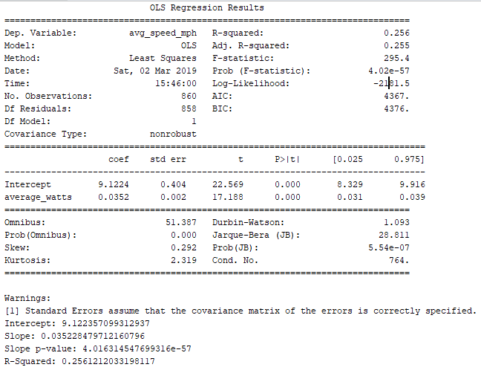
10. For this project, conduct a regression analysis on either one dependent and one explanatory variable, or multiple explanatory variables.
Regression (Single Predictor): Average Speed and Average Watts
The p-value associated with average_watts is far less than .001, which implies statistical significance.
The R² value of .26 is reasonably high and the f-stat, which indicates the significance of the model as a whole is also far less than .001.
This regression is little more than a fancy correlation analysis in this case. For that reason, and because of the previously reported lower correlation than expected, a multiple regression analysis is more appropriate.
I did the single predictor regression just to confirm and enhance prior work.

Slide 18
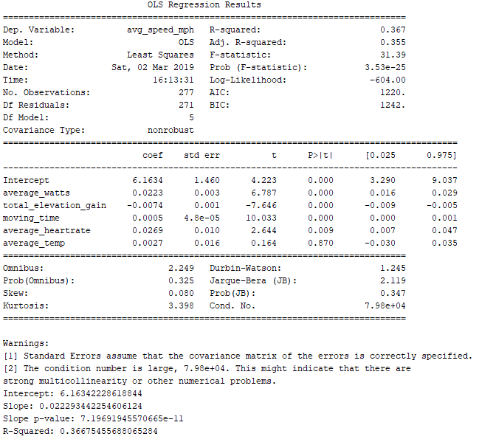
10. For this project, conduct a regression analysis on either one dependent and one explanatory variable, or multiple explanatory variables.
Regression (Multiple Predictors): Average Speed and Everything Else*
The coefficients for the predictors are mostly low except for average_wattas and average_heartrate. Each increase speed as they increase, except total_elevation_gain, which lowers speed, which is pretty intuitive from a cycling perspetive.
The R² value of .37 is higher than just power, but it’s hard to tell why that is. The significance of the model as a whole is also far less than .001. This implies statistical significance.
However, there appears to be multicollinearity in the model as a whole, which was expected (even without distance_mi). I thought average_temp was the culprit but it’s more than that (I removed it and the condition number was still large).
* I removed distance_mi because I already know this is highly correlated with watts, creating multicollinarity.

